Slide 1
Colin Michael DSC 680: Project 3 Saturday, June 1st, 2024 diabetes predictions

Slide 2
diabetes
Diabetes is a health condition that impacts how people turn food into energy
Diabetes prevents people from either making enough insulin to properly function or inhibits how insulin functions.
This leads to blood sugar staying in people’s bloodstream too long
Excessively high blood sugar causes health complications like heart failure, kidney failures, and vision loss

Slide 3
Research Plan
For this project, I will be assuming the role of a data scientist employed by the American Center for Disease Control.
My objective will be to utilized existing diabetes data sets to create predictive models aimed at helping to treat at-risk individuals for diabetes.

Slide 4
Data set explanation
I will be using a csv dataset from Kaggle, which was originally from the laboratory of Medical City Hospital of Iraq
The data includes 14 column:
No. of Patient, Sugar Level Blood, Age, Gender, Creatinine ratio(Cr), Body Mass Index (BMI), Urea, Cholesterol (Chol), Fasting lipid profile, including total, LDL, VLDL, Triglycerides(TG) and HDL Cholesterol , HBA1C, Class (the patient's diabetes disease class may be Diabetic, Non-Diabetic, or Predict-Diabetic).
Class will be the dependent variable I am studying, with the remaining variables as independent variables.

Slide 5
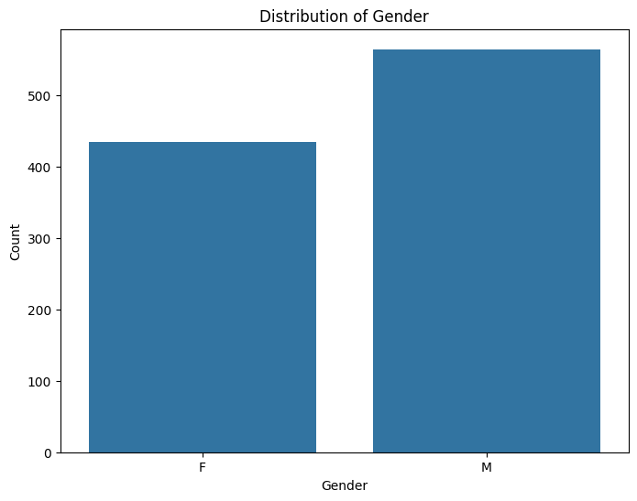
Data Visualizations: Gender

Slide 6
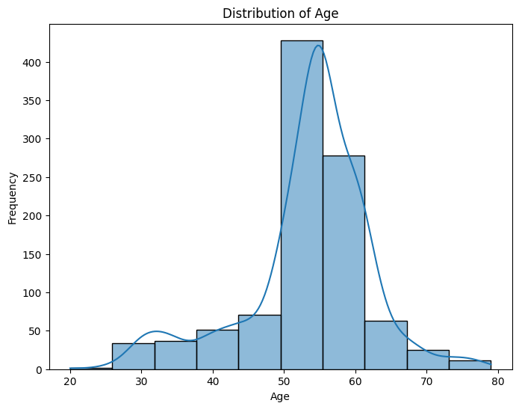
Age Distribution

Slide 7
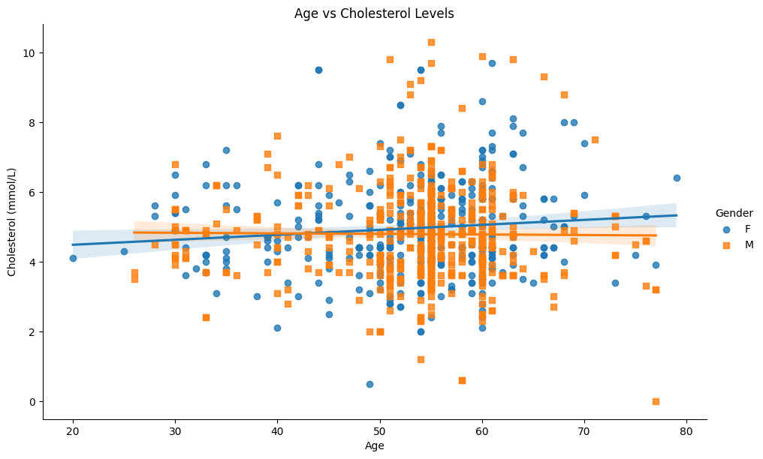
Age vs Cholesterol

Slide 8
Data science methodology
I decided to create a random forest model for my diabetes analysis
A random forest model is a machine learning method that uses classification and regression
Decision trees predict outcomes by splitting data based on features

Slide 9
Random Forest Model
Random Forest Accuracy: 0.9842105263157894
Classification Report:
precision recall f1-score support
N 0.90 0.95 0.93 20
Y 0.99 0.99 0.99 170
accuracy 0.98 190
macro avg 0.95 0.97 0.96 190
weighted avg 0.98 0.98 0.98 190

Slide 10
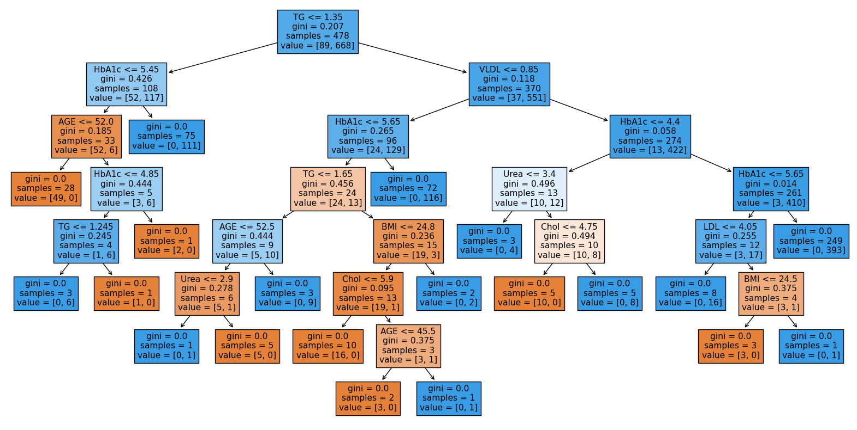
Random Forest Tree

Slide 11
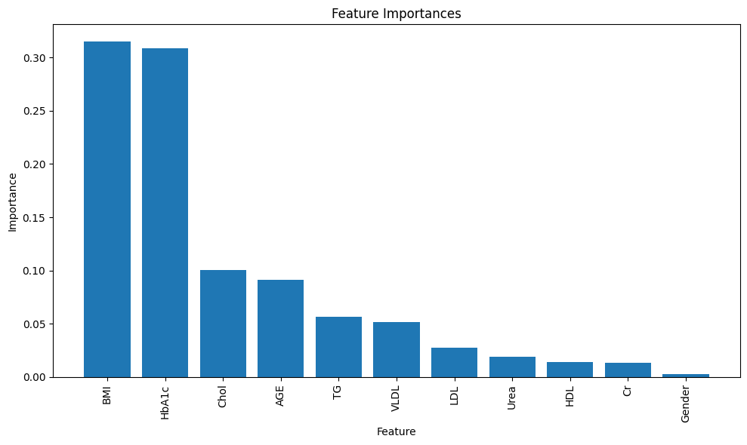
Feature Importances

Slide 12
Result Accuracy
The model has an overall accuracy of 98.4%, which is very good
90% precision of N means that when the model predicts N, it is correct 90% of the time
The model has a 99% precision on Y, which is excellent

Slide 13
Results analysis
The data shows that BMI is the greatest indicator of diabetes
A close second is HbA1c
Cholesterol and age are third and fourth, but there is a significant drop in their feature importances
This model suggests that BMI and HbA1c are the most important factors to focus on when looking at diabetes outcomes

Slide 14
Ethical considerations
I want to avoid reinforces negative stereotypes in my project, and instead focus on helping people
I do not want my research to be used to create prejudice against factors like Body Mass Index and Age
BMI is the greatest predictor of diabetes, but these results should not be used to shame people. Instead, they should be used towards motivating and inspiring people to make healthy lifestyle choices aimed at controlling BMI

Slide 15
10 Questions
Why did I choose to study diabetes?
What made me choose a random forest model?
What surprised me most about my findings?
What other data science methods would be applicable for my data set?
What other medical conditions would be beneficial to study?
How could I improve my random forest model?
What confused you the most about the project?
How would you rate the quality of data?
What methods did you need to take to clean the data?
What other data sets would help this project?

